Slide 1
Anime recommender
Sharma Vijay

Slide 2
Recommendation systems
Recommender systems are one of the most successful and widespread application of machine learning technologies in business.
You can find large scale recommender systems in retail, video on demand, or music streaming. In order to develop and maintain such systems, a company typically needs a group of expensive data scientist and engineers.
Machine learning algorithms in recommender systems are typically classified into two categories — content based and collaborative filtering methods although modern recommenders combine both approaches. Content based methods are based on similarity of item attributes and collaborative methods calculate similarity from interactions.

Slide 3
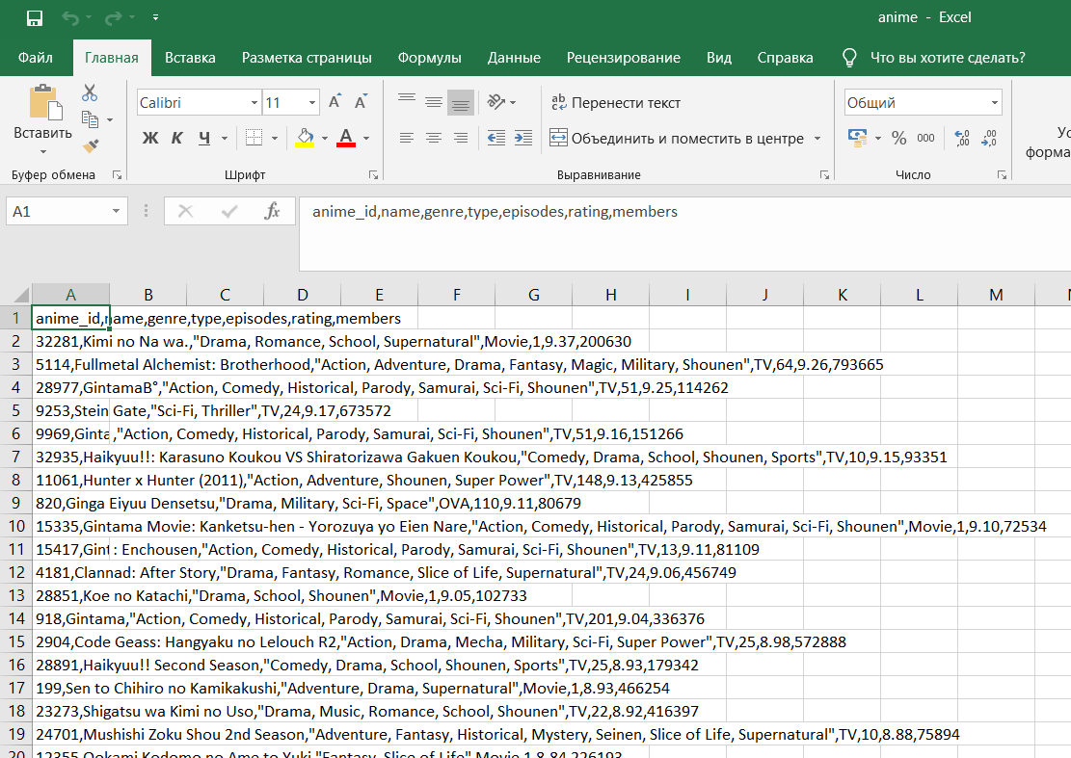
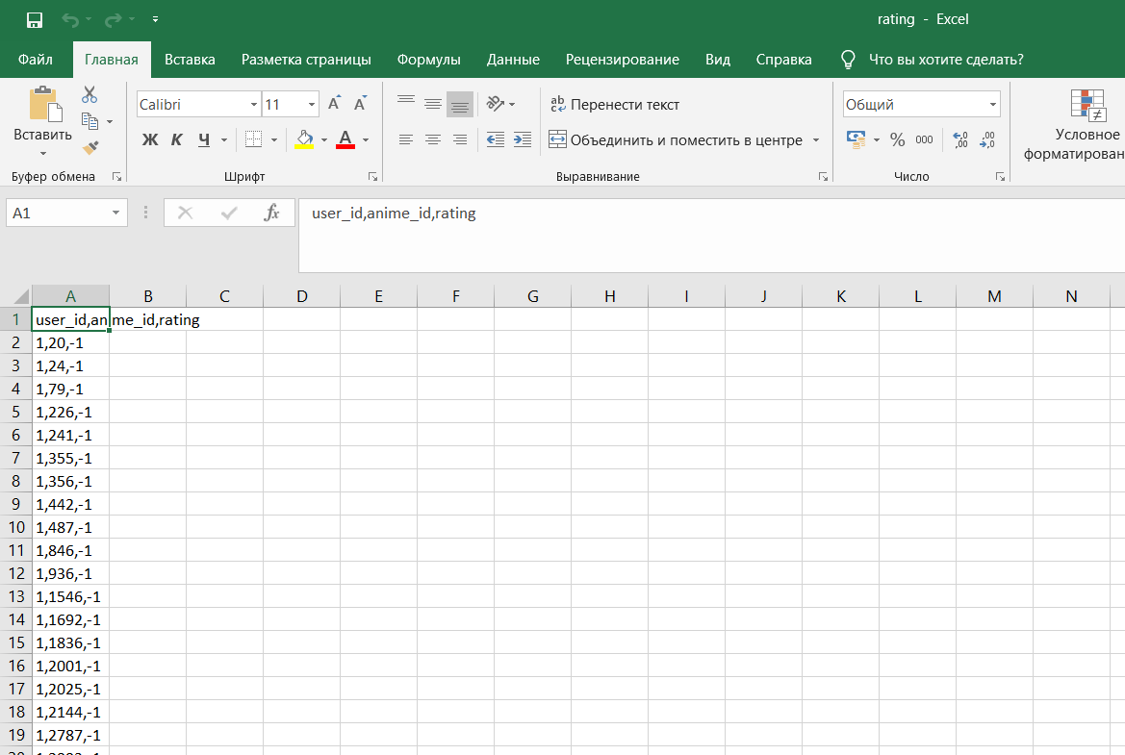
Database
Anime.csv Rating.csv

Slide 4
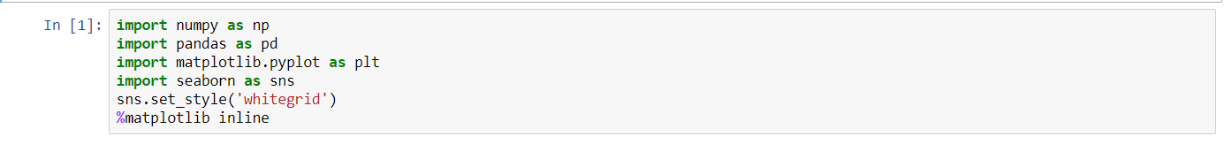
Libraries
NumPy is a library for the Python programming language, adding support for large, multi-dimensional arrays and matrices, along with a large collection of high-level mathematical functions to operate on these arrays.
Pandas is a software library written for the Python programming language for data manipulation and analysis. In particular, it offers data structures and operations for manipulating numerical tables and time series.
Seaborn is a Python data visualization library based on matplotlib. It provides a high-level interface for drawing attractive and informative statistical graphics.
Matplotlib is a Python 2D plotting library which produces publication quality figures in a variety of hardcopy formats and interactive environments across platforms.

Slide 5
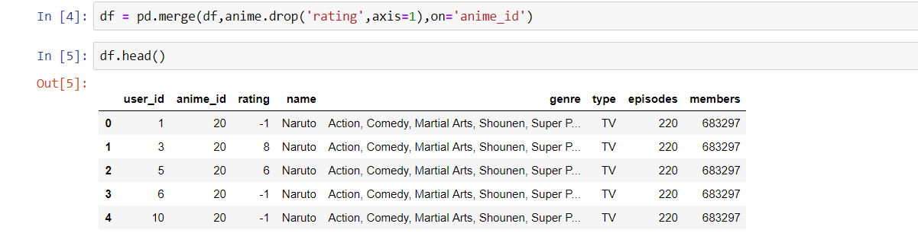
Data reading and preprocessing

Slide 6
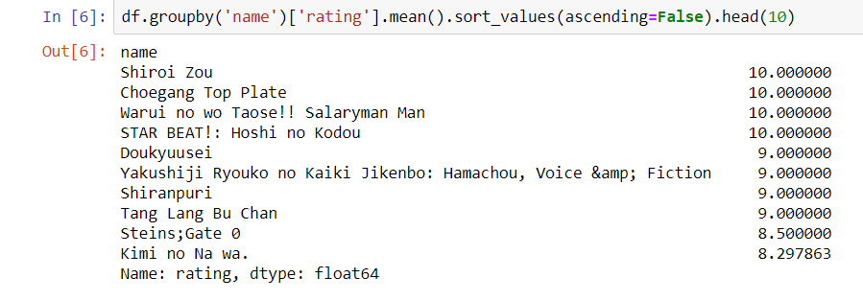
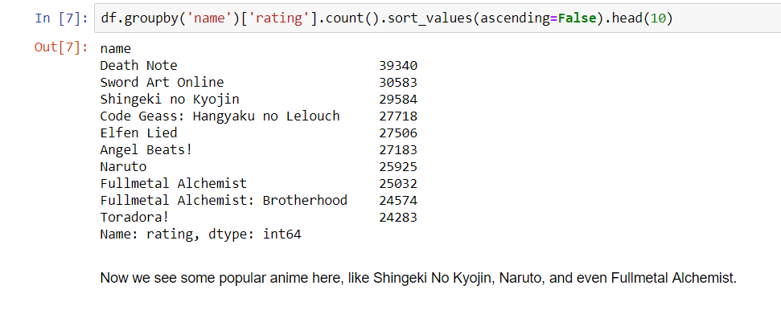
Let's check anime by its rating
It seems something's not good there. It might be because of animes with 10 rating only got a few users watched them so the rating goes up so high. So, I need another attribute in order to get better recommendation. number of users seems logical since the more users watched the anime, higher probability the anime gets the actual rating based on many users.
Now we see some popular anime here, like Shingeki No Kyojin, Naruto, and even Fullmetal Alchemist.

Slide 7
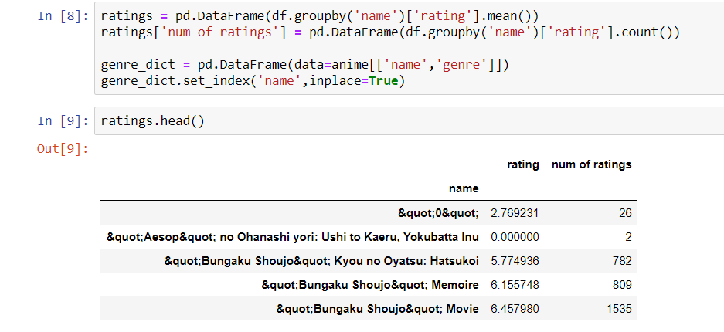
Exploratory Data Analysis

Slide 8
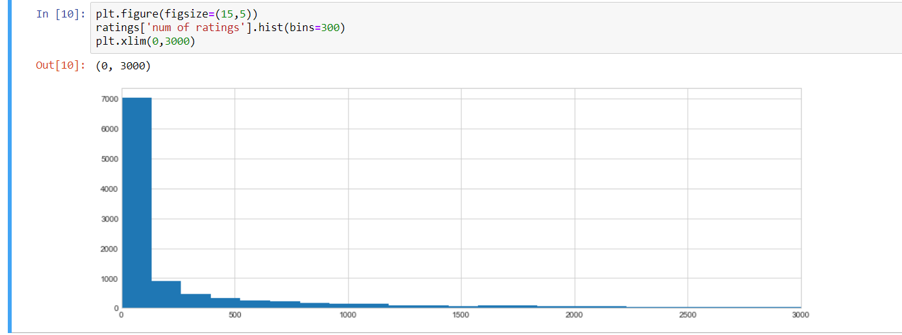
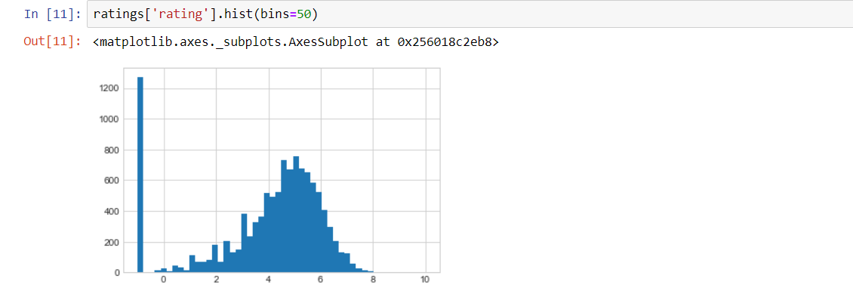
Next thing is to check anime number of ratings distribution

Slide 9
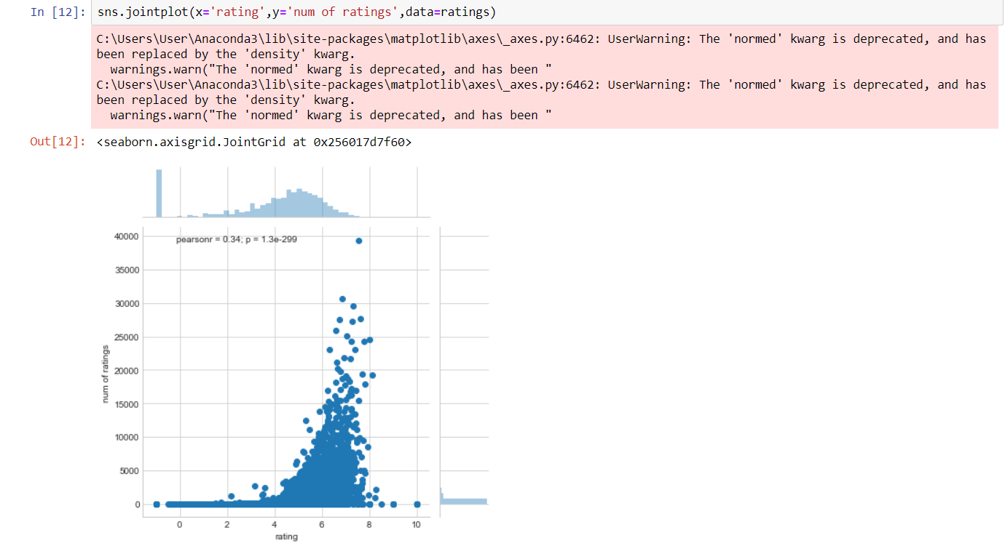
From the plot above, as more people rate anime then there is a high chance for anime to get high rating

Slide 10
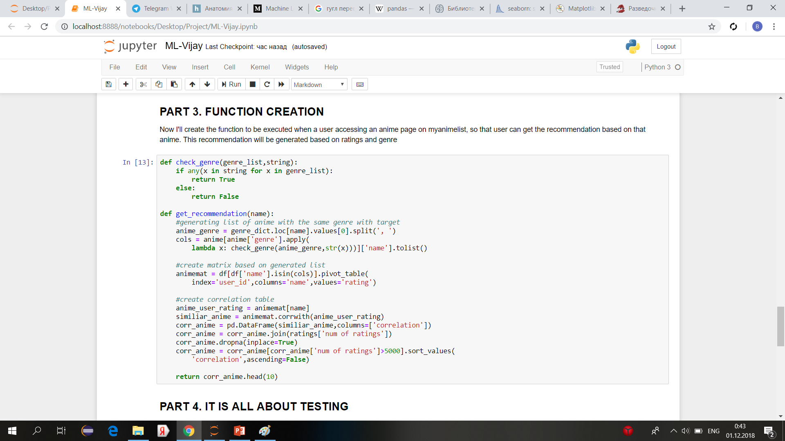
Function creation

Slide 11
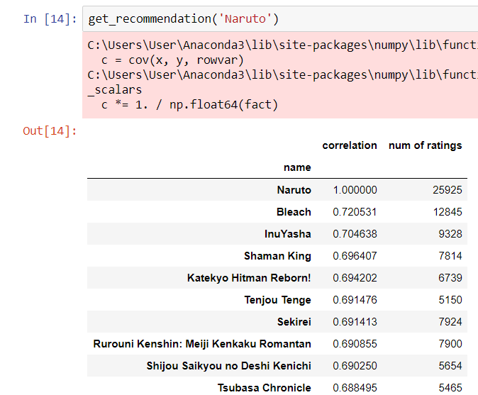
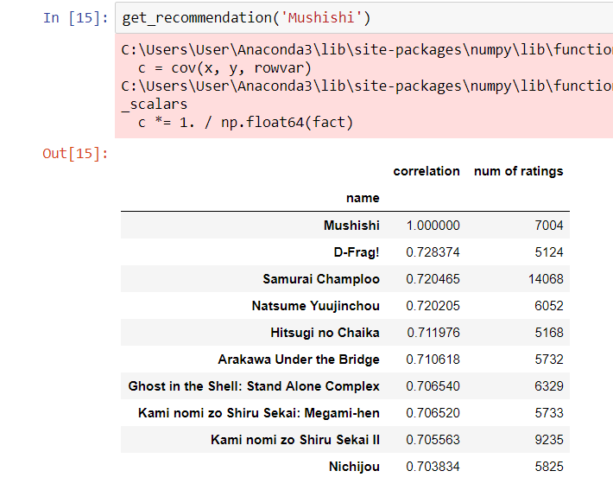
Testing

